Slide 1
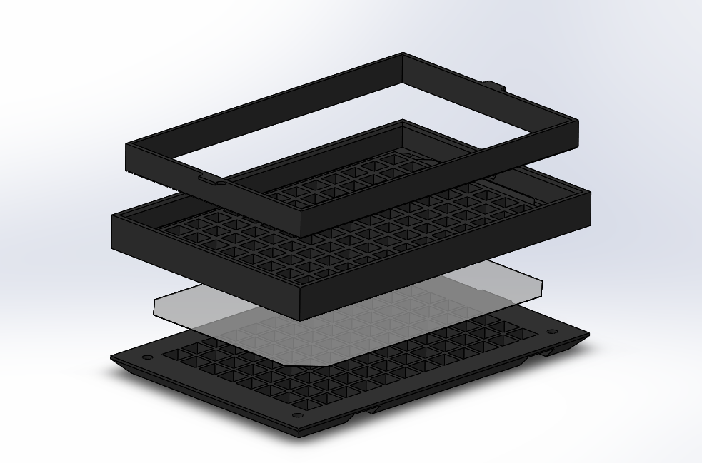
Figure S1
4
3
2
1
OptoPlateToNunc265300_BottomHalf
Diffuser sheets (Rosco, #3008)
OptoPlateToNunc265300_Tophalf
OptoPlateToNunc265300_Top

Slide 2
Figure S2
Start
Mount light sensor to microscope
Mount optoPlate to microscope
Flash initial calibration values
Measure LEDs
Checker 1
Left LEDs
Checker 1
Right LEDs
Checker 2
Right LEDs
Flash updated calibration values
Checker 2
Left LEDs
Analyze measurements
Calibrated?
End

Slide 3
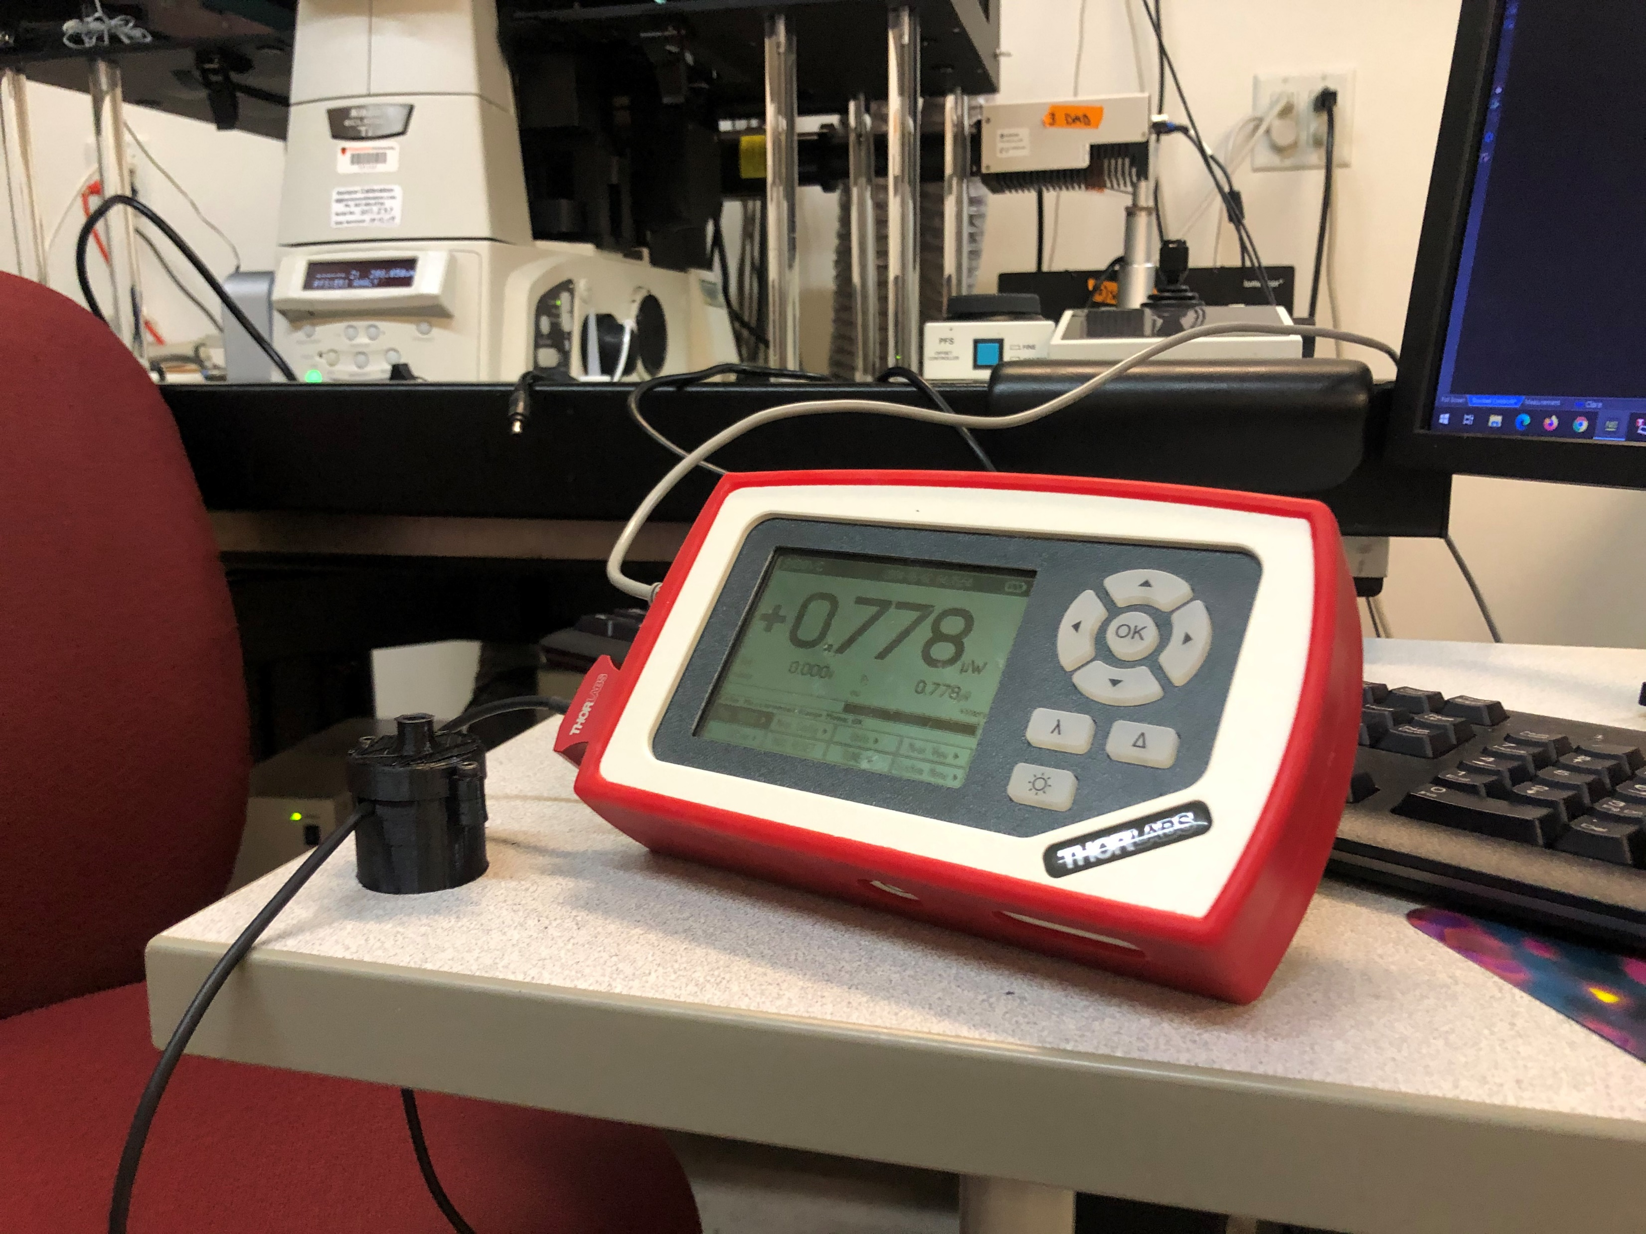
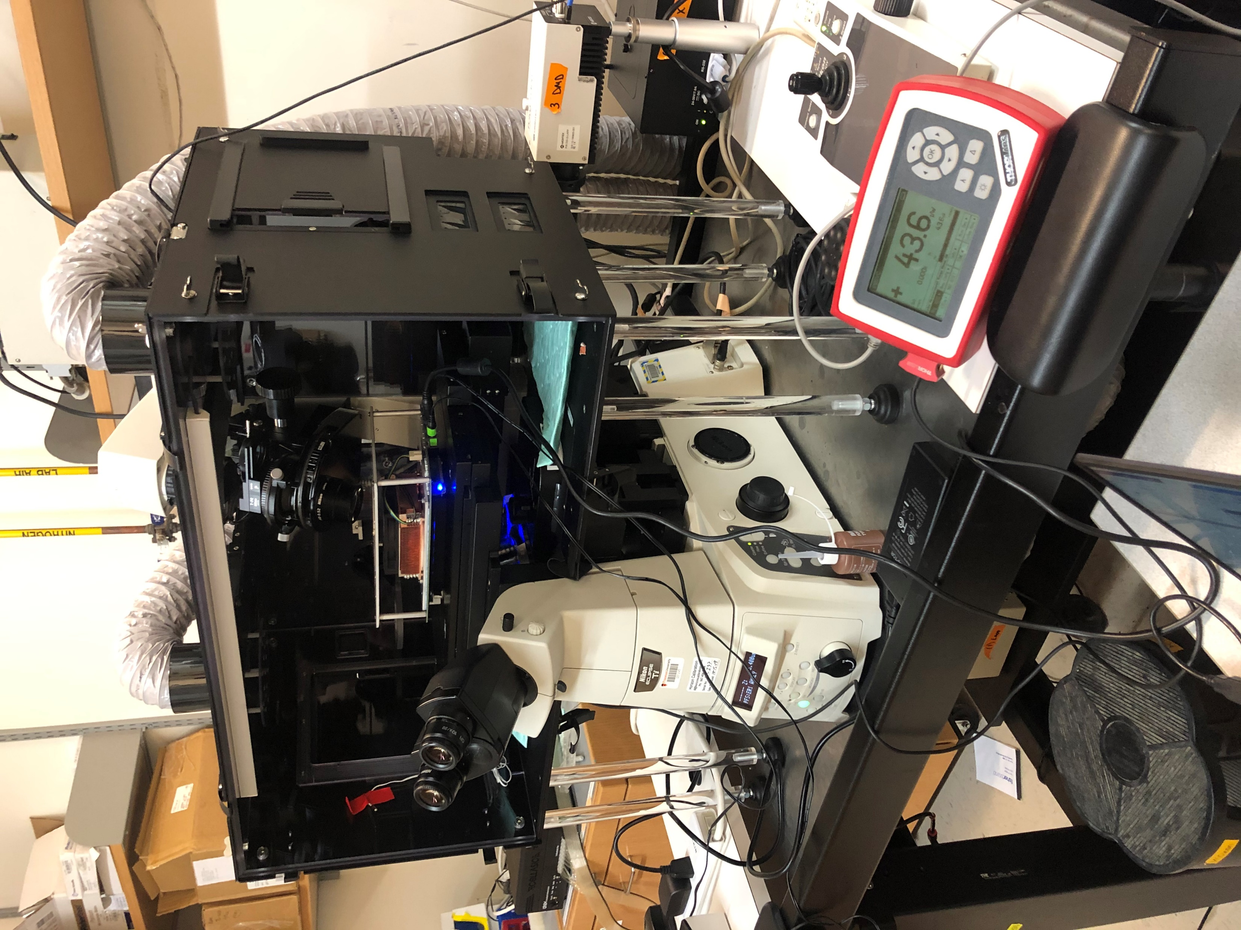
Figure S3
A
B
3
1
2
4
1
Thorlabs S120VC optical power meter mounted between the upper and lower optical power sensor adapters. Shown on its own (A) and mounted to the objective turret of a microscope (B)
Thorlabs PM100D records irradiance measurements
optoPlate mounted to a Nunc 96 well plate optical bottom plate atop a programmable microscope stage via the optoPlate-to-Nunc adapter and with the secondary optoPlate-to-Nunc adapter (to mount the optoPlate upside-down)
Microscope with programmable stage used to raster the optical power sensor across the optoPlate LEDs

